Slide 1

UNIVERSITI TEKNOLOGI MALAYSIA
FYP 1 PRESENTATION
Inventory Management System for Kelab Fotokreatif (IFoto)
Prepared by: Lio Kock Hock
Supervised by: Dr. Muhammad Khatibsyarbini Bin Abd Rahim

Slide 2
Overview
1. Introduction
2. Literature Review
3. System Development Methodology
4. Requirements Analysis and Design
5. Conclusion

Slide 3
INTRODUCTION

Slide 4
Problem Statement
Lack of structured tracking causes double bookings and miscommunication.
Equipment Booking is done via personal messages or phone calls.
Equipment Executive experiences work overload, especially during peak events.
Equipment logs are managed manually using Google Sheets, which is inefficient and hard to scale.
Rental and payment process is slow, relying on WhatsApp or verbal requests.
No automatic invoice and receipt generation.

Slide 5
Project Aim
real-time equipment tracking
centralized equipment management
online equipment booking and payment
role and event management

Slide 6
01
Requirements Analysis
To analyse and determine the necessary requirements to develop IFoto.
Project Objectives
02
System Design
To design a web-based application that ensures intuitive interaction and is easy for users to navigate.
03
System Implementation
To develop IFoto based on the stakeholders’ requirements.
04
System Testing
To manage the testing process on functionality and non-functionality of IFoto with the stakeholders.

Slide 7
Project Scope
The Inventory Management System for Kelab Fotokreatif (IFoto) is built as web application for broader range of device accessibility.
01
03
Administrator
Equipment Committee Member
The system includes four main users for Administrators, Equipment Executive Committee, Equipment Committee Member, and User.
manage the club member roles and event.
can request for the club’s equipment for an event.
02
04
Equipment Executive Committee
User
monitor and manage the club’s equipment and equipment booking workflow.
rent club’s equipment and make payment through the web application.

Slide 8
LITERATURE REVIEW

Slide 9
Current System Analysis
Features | Rentman | Cheqroom | IFoto
Target Users | Professional AV Industries | Schools, universities, and corporate IT teams | Kelab Fotokreatif
Purpose | Equipment rental, crew scheduling, logistics | Equipment check-in/check-out and asset tracking | Club-oriented equipment management and rental system
Supports External Rentals | Yes | Yes | Yes
Multi-role Access | Yes | Yes | Yes
Real-time Availability Tracking | Yes | Yes | Yes
Mobile Accessibility | Yes | Yes | Yes
Online Payment Integration, Receipt and Invoice Generation | No | No | Yes
Event-Based Equipment Assignment | Yes | No | Yes
Integrated Role & Event Management | Yes | No | Yes
Cost | Subscription-based | Subscription-based | Free

Slide 10



Technology Used For Development
Technology Used | Description
ReactJS | a JavaScript library and framework that is open-source and created by Facebook. It contains React Redux.
Spring Boot | an open-source Java-based framework and vast library developed by Pivotal Software.
MySQL | A popular open-source relational database management systems (RDBMS) that is managed by using SQL.
GitHub | It offers cloud-based services for hosting Git repositories.
Visual Studio Code | A robust source code editor.
Enterprise Architect | A comprehensive modelling tool that helps software engineers to develop system design using Unified Modelling Language (UML).
Postman | An Application Programming Interface (API) platform that is utilized in the development, testing and management of APIs.

Slide 11
System Development Methodology

Slide 12
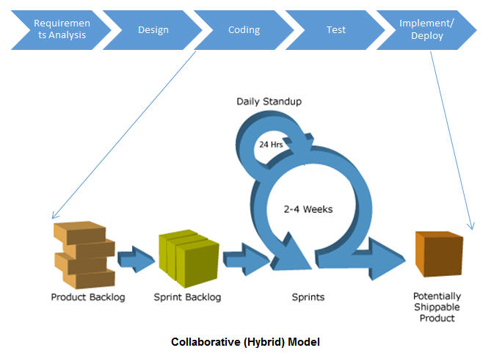
Hybrid Agile-Waterfall Methodology
Requirement analysis and system design will be implemented by using Waterfall model
System Coding, unit testing and deployment will be implemented by using Agile model.

Slide 13
Hybrid Agile-Waterfall Methodology
Requirement Analysis
Coding & Implementation
System Deployment
All user demands and business requirement are gathered, analyse and recorded.
Implementation are divided into sprints to be developed iteratively to ensure frequent releases
The new features or updates are regularly and incrementally released in small batches to users
1
3
5
2
4
System Design
System Testing
Creating high-level, thorough design documentation and design system architecture.
Test on each sprint continuously as new features are being developed and implemented.

Slide 14
Software Requirement
Software | Requirements
Google Chrome & Microsoft Edge | Version 80 or later (Latest: Version 138)
Safari | Version 12 or later
Visual Studio Code | Version 1.60 or later
Java | JDK 17 or later
JavaScript (ES6+) | Any modern browser
Spring Boot | Version 3.2.x or later
ReactJS | Version 18 or later
MySQL | Version 8.0 or later
GitHub | access via browser

Slide 15
Hardware Requirement (Computer/Laptop)
Hardware | Requirements
Operating System | Windows 7 (64-bit) or later version
 | macOS 10.15 (Catalina) or later version
 | Ubuntu 20.04 LTS or equivalent or later version
Processor | Intel Core i3 (8th Gen or later) or higher
 | AMD Ryzen 3 (3000 series or later) or higher
 | Apple M1 or M2 (for macOS users)
RAM | 8 GB

Slide 16
Hardware Requirement (Computer/Laptop)
Hardware | Requirements
Operating System | Android 10 (Q) or newer
 | iOS 13 or newer
Processor | Snapdragon 665 / Exynos 9611 / Equivalent or higher
 | Apple A11 Bionic (iPhone 8) or higher
RAM | 4 GB

Slide 17
Requirement Analysis and Design

Slide 18
Use Case Diagram of IFoto

Slide 19
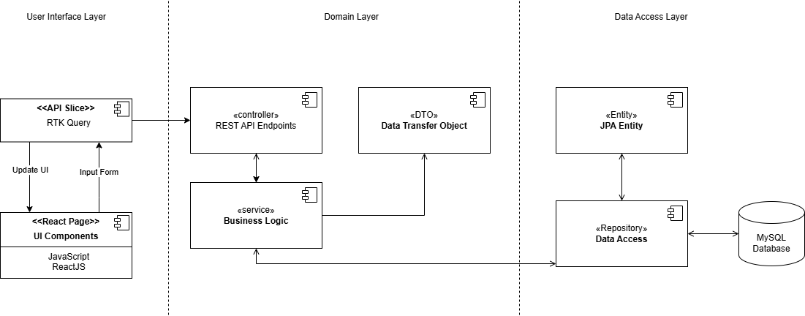
System Architecture of IFoto
3-Tier Architecture

Slide 20
System Architecture of IFoto
Package Diagram (Architectural View)

Slide 21
System Architecture of IFoto
Package Diagram (Modules)

Slide 22
System Architecture of IFoto
Component Diagram (Frontend)

Slide 23
System Architecture of IFoto
Class Diagram (Backend)

Slide 24
System Architecture of IFoto
Class Diagram (Equipment Rent and Request Module)

Slide 25
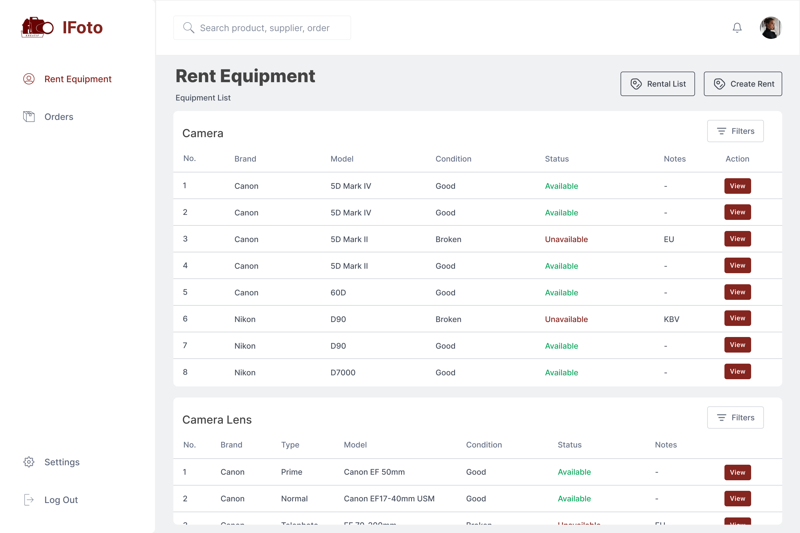
User Interface of IFoto
Rent Equipment (Equipment List)

Slide 26
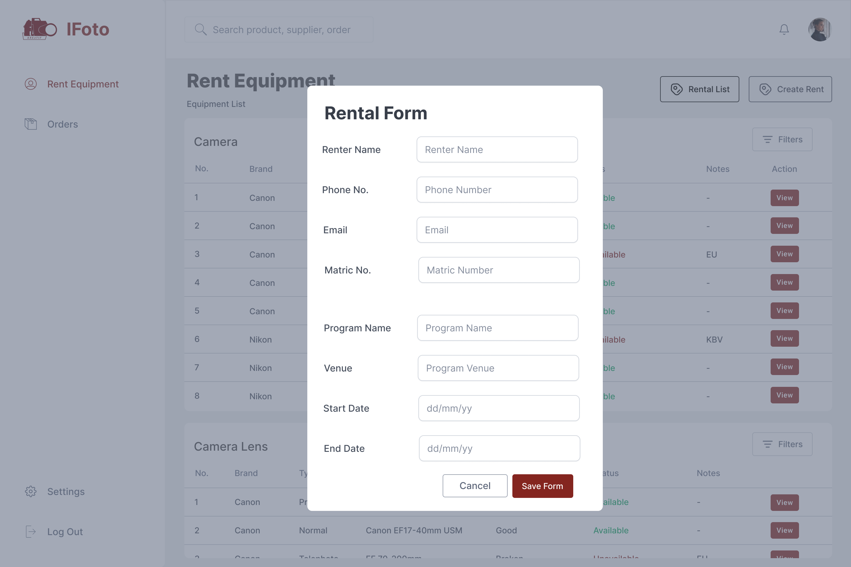
User Interface of IFoto
Rent Equipment (Create Rental Form)

Slide 27
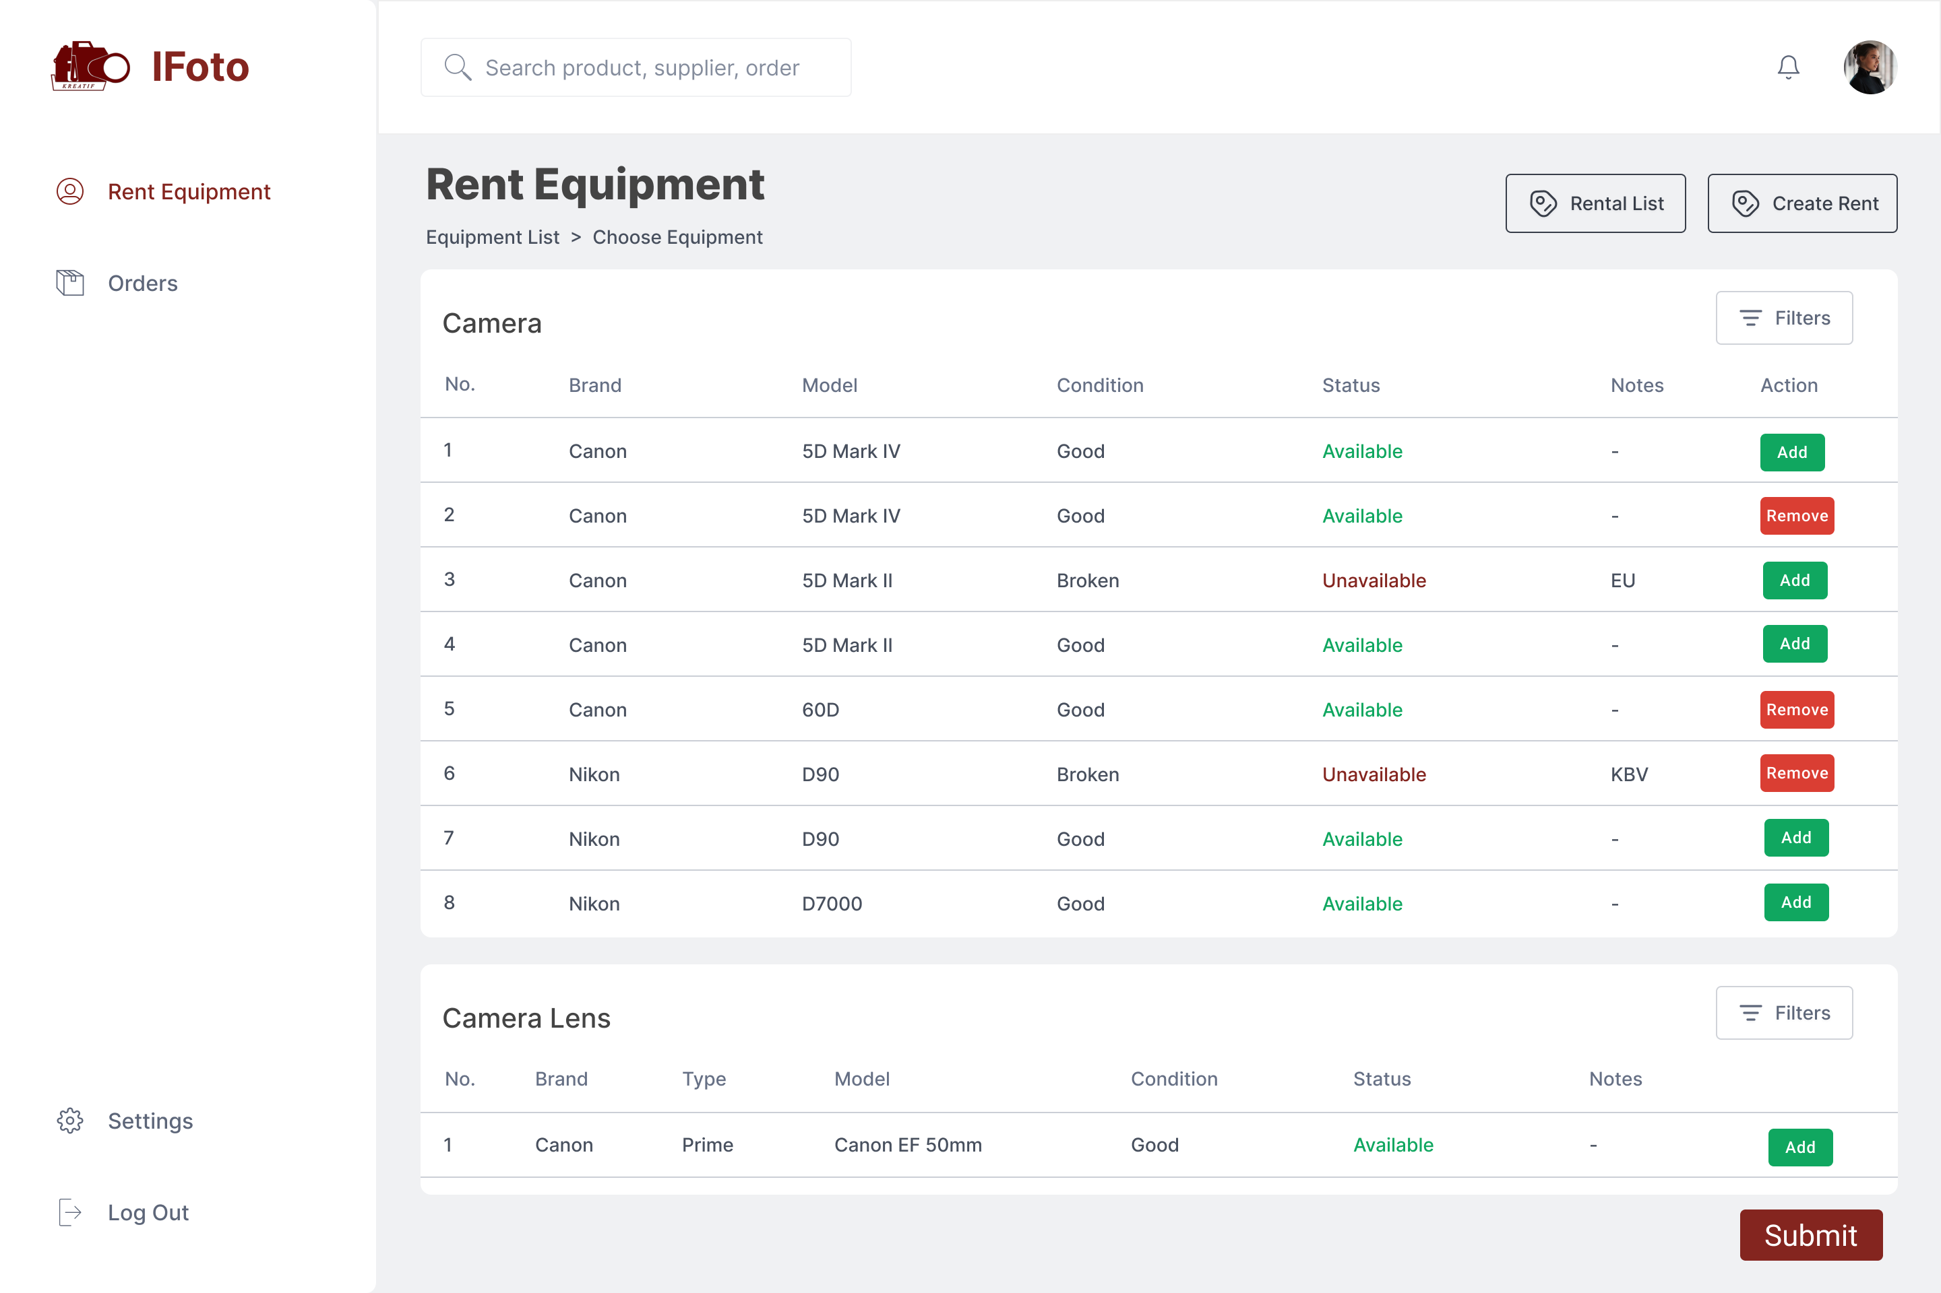
User Interface of IFoto
Rent Equipment (Adding Equipment)

Slide 28
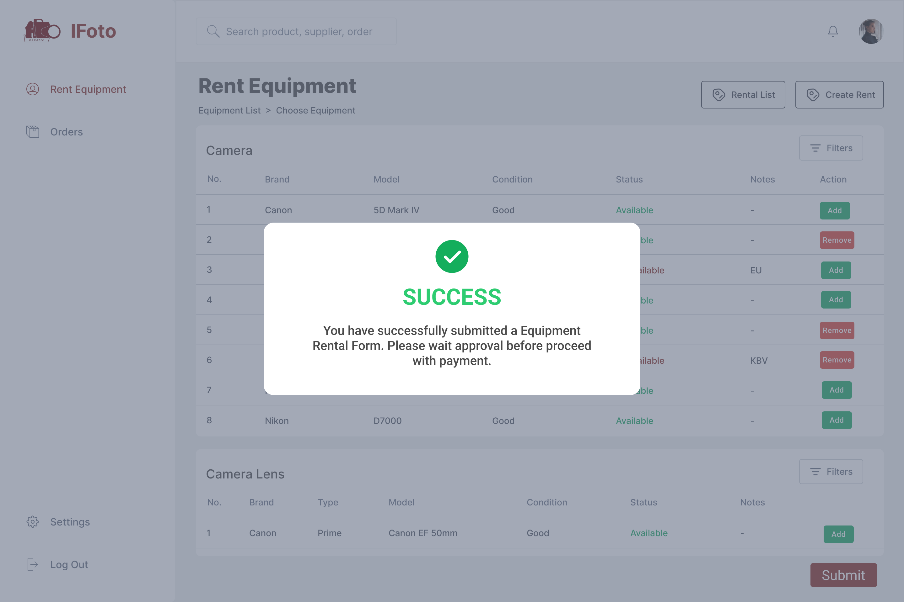
User Interface of IFoto
Rent Equipment (Successful Message)

Slide 29
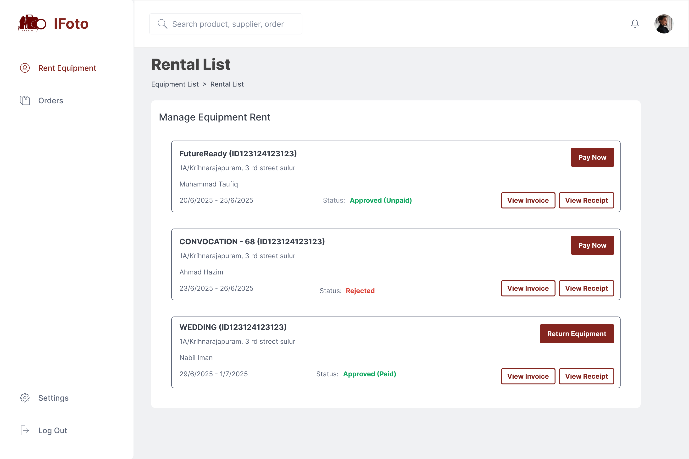
User Interface of IFoto
Rent Equipment (Rental List)

Slide 30
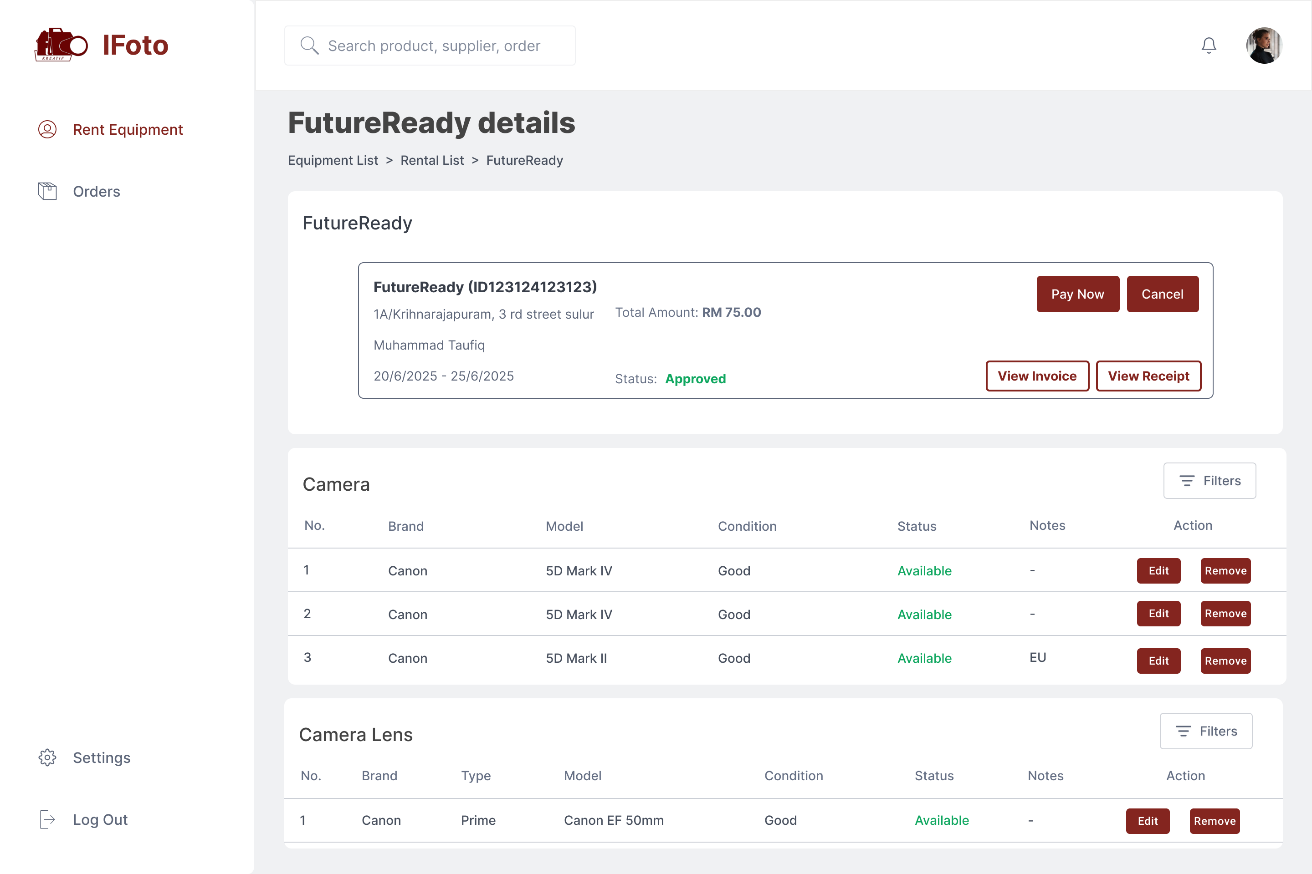
User Interface of IFoto
Rent Equipment (Rental Details)

Slide 31
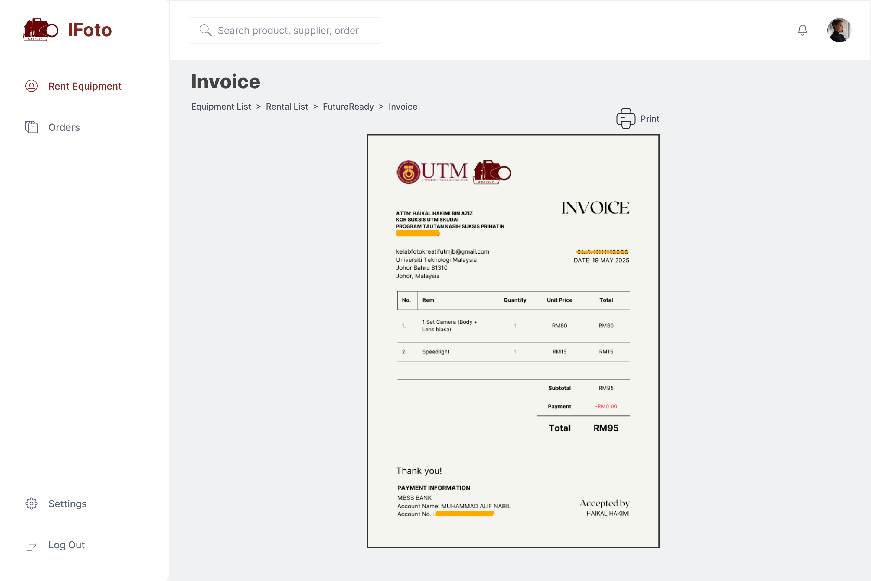
User Interface of IFoto
Rent Equipment (Invoice)

Slide 32
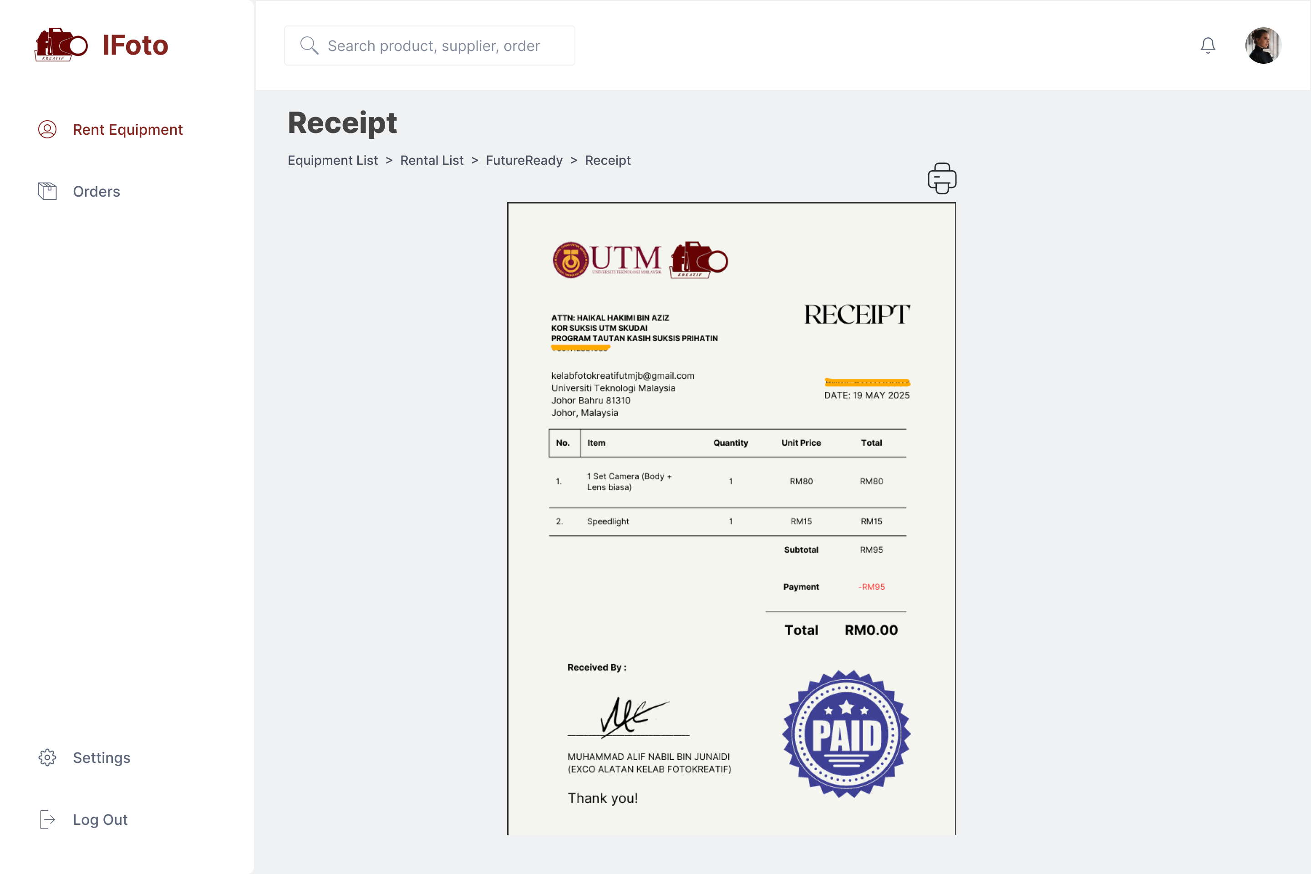
User Interface of IFoto
Rent Equipment (Receipt)

Slide 33
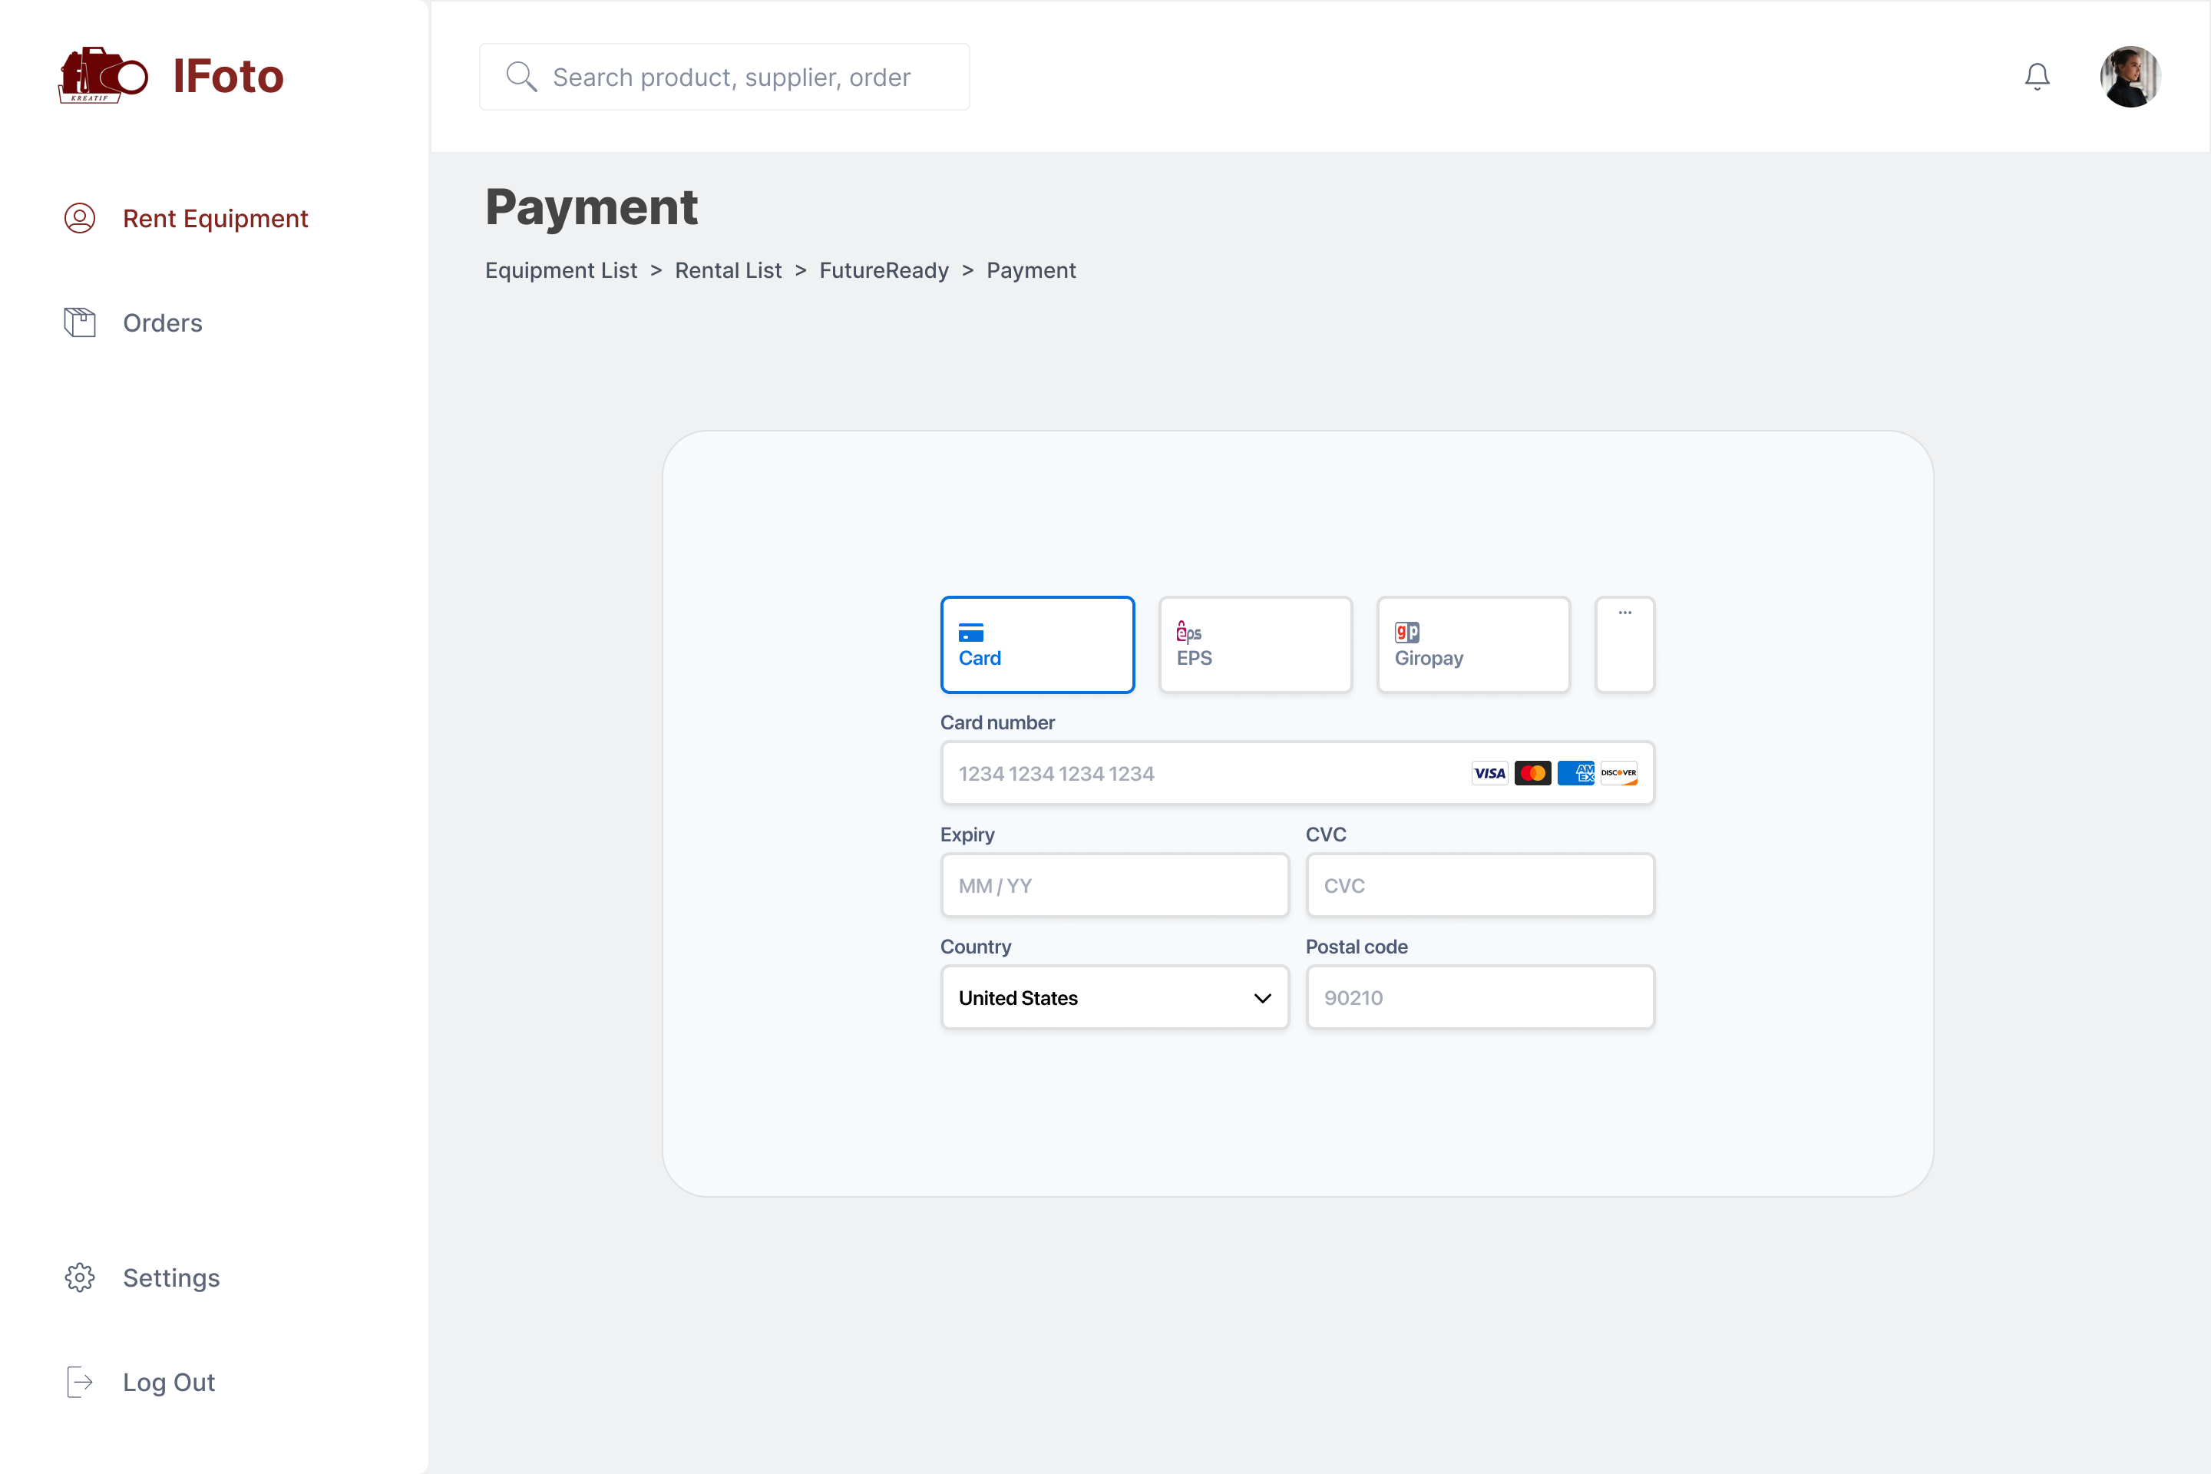
User Interface of IFoto
Rent Equipment (Payment)

Slide 34
CONCLUSION

Slide 35
Conclusion
Kelab Fotokreatif faced challenges in managing equipment manually, leading to double bookings, miscommunication, and inefficient tracking.
IFoto was developed as a centralized, web-based inventory system that enables equipment booking, tracking, role-based access, and real-time availability updates.
✔ Streamline equipment management ✔ Provide transparent rental process with payment and invoicing ✔ Event-based equipment assignment
Advanced Analytics & Reporting and User Feedback Integration can be added for future improvement,.

Slide 36


THANK YOU
utmofficial
univteknologimalaysia
utm.my

